Slide 1
UNIT-I Introduction to Computer Networks

Slide 2
NETWORK:
A network is a set of devices (often referred to as nodes) connected by communication links.
A node can be a computer, printer, or any other device capable of sending and/or receiving data generated by other nodes on the network.
Computer Network:
A computer network is a set of computers that are connected together so that they can share information.
or
Computer network means to connect multiple computer system with each other through physical medium (Cable or Wire) or wireless medium and this architecture is known as “Computer Network“.
In traditional computer networks, single computer machine, workstation, and servers are linked one by one through Ethernet and other cables.
But now, advance technologies are released in market in which to make connection between multiple points through wireless technology.

Slide 3
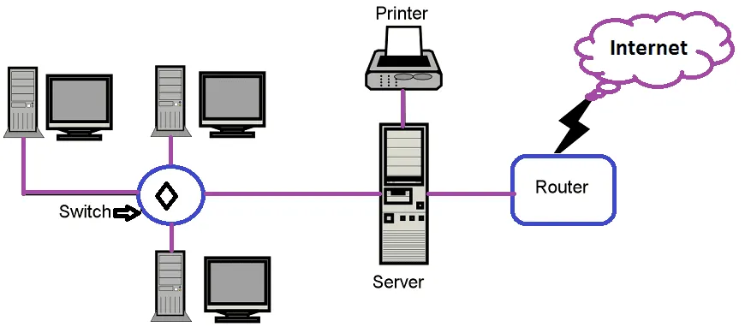
Sample Computer Network

Slide 4
Computer Network provides several uses, both to organizations and individual users.
Resource Sharing
This is the main purpose of a computer network. It defines creating all programs, peripherals and data feasible to anyone computer on the network to all other computers without considering the physical areas. Thus a user at a considerable distance can share the resources or see computer data in a similar way that a local customer uses them.
Another method of resource sharing is load sharing. If a job is needed, it can be implemented using various computers in a network by partitioning it, which reduces time consumption and loads both things for a particular computer.
USES of Computer Networks:
Computer Network provides several uses, both to organizations and individual users.
Resource Sharing
This is the main purpose of a computer network.
It defines creating all programs, peripherals and data feasible to anyone computer on the network to all other computers without considering the physical areas.
Thus a user at a considerable distance can share the resources or see computer data in a similar way that a local customer uses them.
Another method of resource sharing is load sharing.
If a job is needed, it can be implemented using various computers in a network by partitioning it.
which reduces time consumption and loads both things for a particular computer.

Slide 5
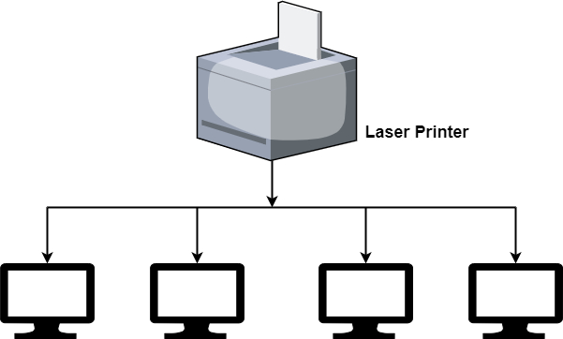
Resource sharing example

Slide 6
Simultaneous Access
computer network allows few users to create programs and data at the equivalent time.
An example is a company’s quarterly sales document, which several managers need to view and update.
We can store the information on a network server, which is a central computer with a huge storage device and other resources that all users can share.
If the server stores files for users to access, it is generally known as a file server.
We can save an individual copy of a data file on the server, accessible to each employee in the organizations, as display in the figure.
Moreover, if one user changes the file, other users will see the difference when using it.

Slide 7
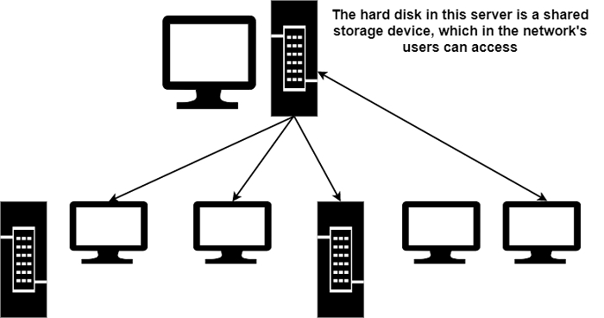
Simultaneous Access
computer network allows few users to create programs and data at the equivalent time. An example is a company’s quarterly sales document, which several managers need to view and update. We can store the information on a network server, which is a central computer with a huge storage device and other resources that all users can share.
If the server stores files for users to access, it is generally known as a file server. We can save an individual copy of a data file on the server, accessible to each employee in the organizations, as display in the figure. Moreover, if one user changes the file, other users will see the difference when using it.

Slide 8
High Reliability due to Alternative Sources of Records
Reliability is the main benefit due to which networks are becoming very popular among organizations.
By using systems, critical data can be saved at more than one locations.
If a computer fails or crashes, the data can be recovered from the network’s other computers.
This way, the data is secured in a network.
Cost Reduction
The next phase of the computer network is the reduction of cost.
Resources sharing automatically reduces cost, and hence money can be saved.
One of the other aspects is that the prices of small computers are significantly less compared to mainframes.
Though mainframes are roughly ten times compared to microcomputers, the cost to performance ratio is much better for small/microcomputers than large/mainframe computers.

Slide 9
Provide Communication Medium
A computer network offers a dynamic communication medium between extensively distinct people.
It is easy for two or more person living far apart to work on the same project by partitioning it using a network.
Uses of Computer Network for People
The computer networks provide the following services to a person.
Access to Remote Information
Access to remote information comes in several forms.
For example,Home shopping, paying telephone bills, e-banking, online share market, etc.
It is possible to access an information system like the World Wide Web, which includes data about the craft, business, cooking, government, health, history, recreation, science, sports, etc.
Newspaper is currently available online. You can access the news according to your interest.

Slide 10
Person-to-Person Communication
Person to person communication involves the following −
Electronic-mail (e-mail)
Teleconferencing and Video Conferencing
A teleconference is a virtual conference in which various people in multiple areas conduct discussions by typing messages.
All the other people can see each message in the teleconference.
If clients have the required hardware and software, they can view and talk to each other as they face online instead of merely typing messages. This process is known as videoconferencing.
Worldwide Newsgroups
Worldwide newsgroups in which one individual posts information and few other subscribers can interpret it or provide feedback.

Slide 11
Interactive Entertainment
Interactive entertainment includes the following −
Video on Demand − It is feasible to choose any movie and displayed it on your screen.
Game Playing − You can enjoy multiperson real-time simulation games.
It can participate in live TV programmes like quiz, contest, discussion, etc.

Slide 12
Network Hardware(Categories of Network)
Technical issues involved in Network design
Two dimension are important here
1.Transimission technology
2.Scale
Transmission technology
There are two types of transmission technologies
1.Broadcast links
2.Point-to-point links

Slide 13
Network Hardware(Contd..)
Broadcast networks
These have single communication channel that is shared by all the machines in the network.
Packet sent by one machine are received by all the others.
Address field is mentioned in the packet specifies intended recipient.
Address matched consider that packet otherwise it ignores .
Broadcast systems also allow a packet to all other systems through special coding in address.
Some broadcast systems also support transmission to subset of machines is called Multicasting.

Slide 14
Network Hardware(Contd..)
Point-to-point networks
These networks consists of many connections between individual pair of machines.
To go from source to destination first it need to visit some intermediate machines.
Multiple routes of different lengths are available finding good one is important in these networks.
Generally Small networks use Broadcasting and larger ones use point to point networks.
Point to point with one sender and receiver is called unicasting.

Slide 15
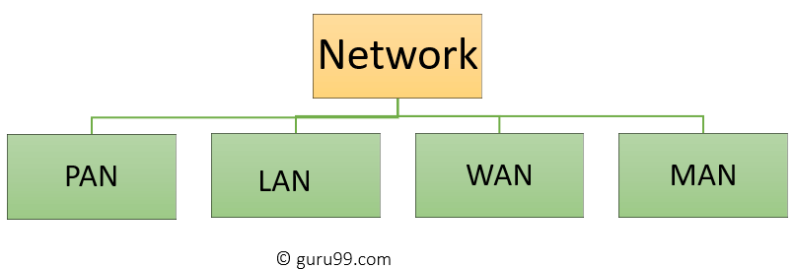
Network Hardware(Contd..)
An alternative Criterion for network classification is Scale.
Classify multiple processor systems by their physical size

Slide 16
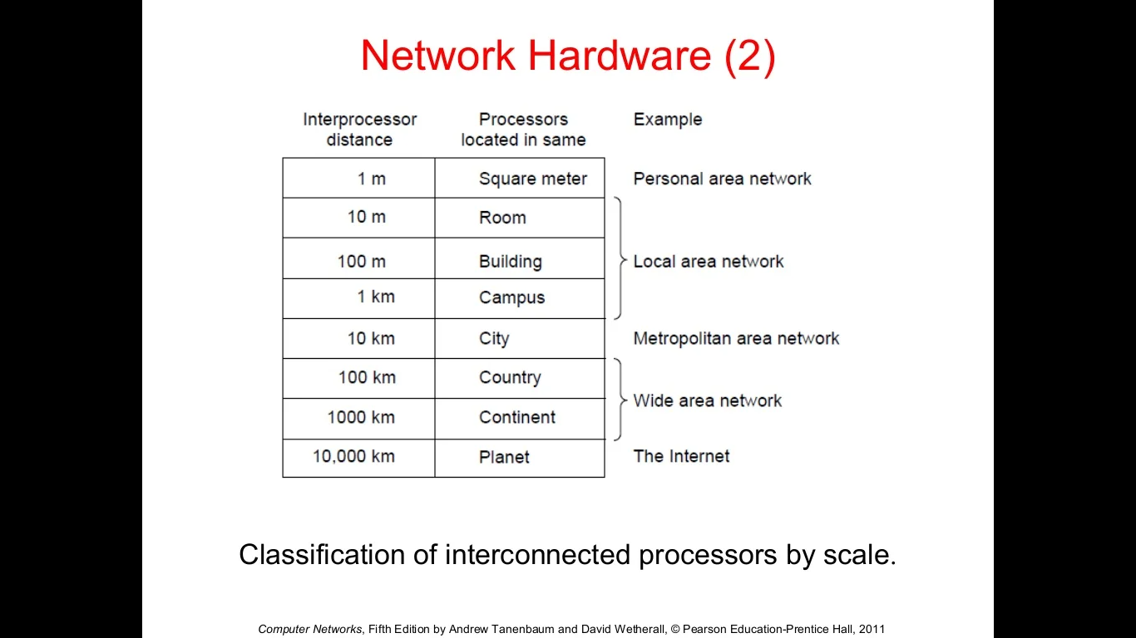
Network Hardware(Contd..)

Slide 17
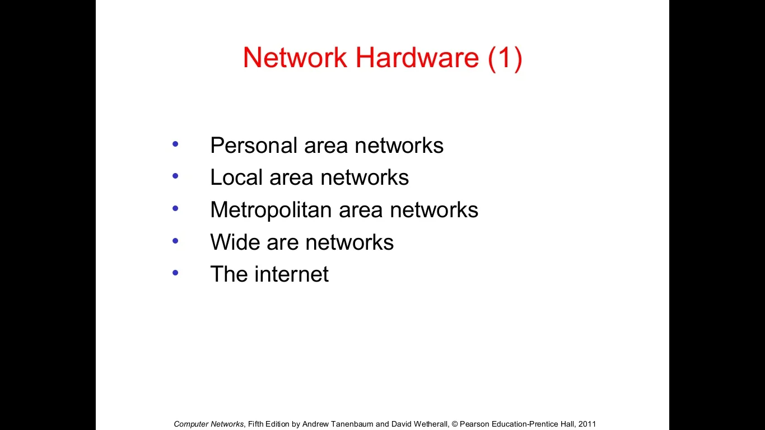
Network Hardware(Contd..)

Slide 18
Network Hardware(Contd..)
PAN (Personal Area Network)
Is a computer network formed around a person.
It generally consists of a computer, mobile, or personal digital assistant.
PAN can be used for establishing communication among these personal devices for connecting to a digital network and the internet.
Characteristics of PAN
Below are the main characteristics of PAN:
It is mostly personal devices network equipped within a limited area.
Allows you to handle the interconnection of IT devices at the surrounding of a single user.
PAN includes mobile devices, tablet, and laptop.
It can be wirelessly connected to the internet called WPAN.
Appliances use for PAN: cordless phone, keyboards, and Bluetooth systems.

Slide 19
Network Hardware(Contd..)
Advantages of PAN
Here are the important pros/benefits of PAN network:
PAN networks are relatively secure and safe
It offers only short-range solution up to ten meters
Strictly restricted to a small area
Disadvantages of PAN
Here are the cons/drawbacks of using PAN network:
It may establish a bad connection to other networks at the same radio bands.
Distance limits.

Slide 20
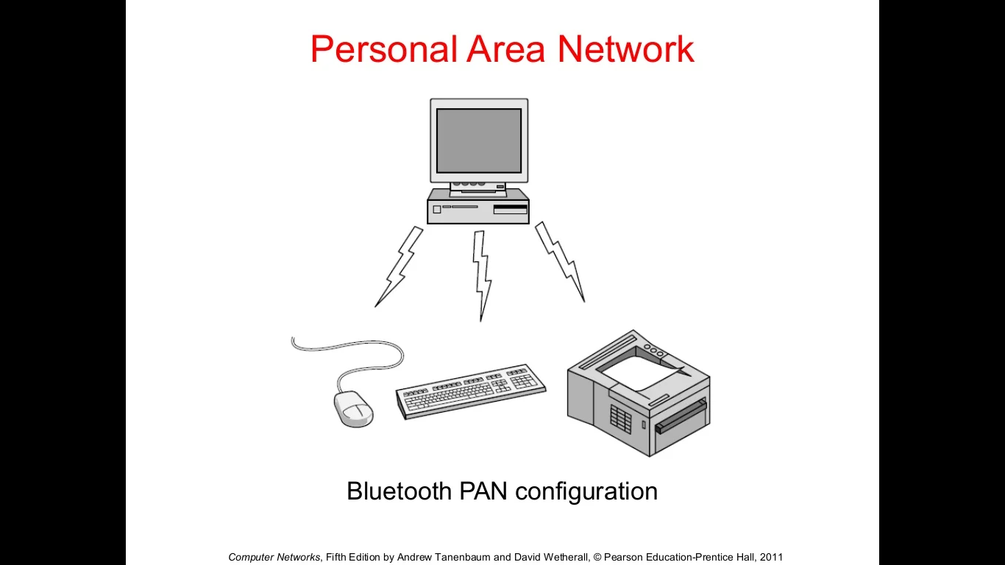
Network Hardware(Contd..)

Slide 21
Network Hardware(Contd..)
LAN (Local Area Network)
A Local Area Network (LAN) is a group of computer and peripheral devices which are connected in a limited area such as school, laboratory, home, and office building.
It is a widely useful network for sharing resources like files, printers, games, and other application.
The simplest type of LAN network is to connect computers and a printer in someone's home or office.
In general, LAN will be used as one type of transmission medium. It is a network which consists of less than 5000 interconnected devices across several buildings.
A Communication medium used for LAN has twisted pair cables and coaxial cables. It covers a short distance, and so the error and noise are minimized.

Slide 22
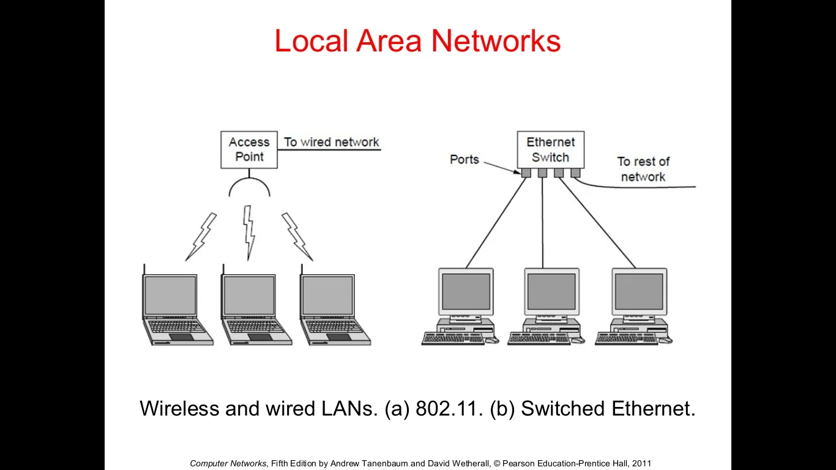
Network Hardware(Contd..)

Slide 23
Network Hardware(Contd..)
Characteristics of LAN
Here are the important characteristics of a LAN network:
It is a private network, so an outside regulatory body never controls it.
LAN operates at a relatively higher speed compared to other WAN systems.
There are various kinds of media access control methods like token ring and ethernet.
Advantages of LAN
Here are the pros/benefits of LAN:
Computer resources like hard-disks, DVD-ROM, and printers can share local area networks. This significantly reduces the cost of hardware purchases.
You can use the same software over the network instead of purchasing the licensed software for each client in the network.

Slide 24
Network Hardware(Contd..)
Data of all network users can be stored on a single hard disk of the server computer.
You can easily transfer data and messages over networked computers.
It will be easy to manage data at only one place, which makes data more secure.
Local Area Network offers the facility to share a single internet connection among all the LAN users.
Disadvantages of LAN
Here are the cons/drawbacks of LAN:
LAN will indeed save cost because of shared computer resources, but the initial cost of installing Local Area Networks is quite high.
The LAN admin can check personal data files of every LAN user, so it does not offer good privacy.
Unauthorized users can access critical data of an organization in case LAN admin is not able to secure centralized data repository.
Local Area Network requires a constant LAN administration as there are issues related to software setup and hardware failures

Slide 25
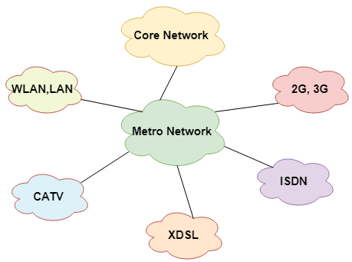
Network Hardware(Contd..)
A Metropolitan Area Network or MAN is consisting of a computer network across an entire city, college campus, or a small region.
This type of network is large than a LAN, which is mostly limited to a single building or site.
Depending upon the type of configuration, this type of network allows you to cover an area from several miles to tens of miles.

Slide 26
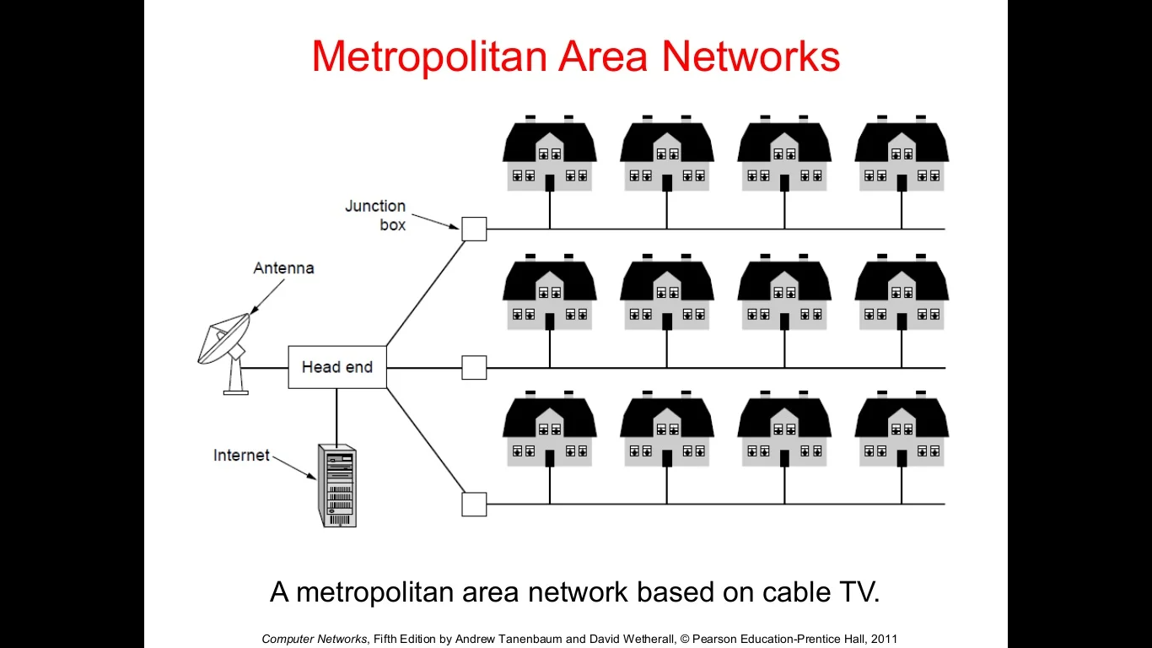
Network Hardware(Contd..)

Slide 27
Network Hardware(Contd..)
Characteristics of MAN
Here are important characteristics of the MAN network:
It mostly covers towns and cities in a maximum 50 km range
Mostly used medium is optical fibers, cables
Data rates adequate for distributed computing applications.
Advantages of MAN
Here are the pros/benefits of MAN network:
It offers fast communication using high-speed carriers, like fiber optic cables.
It provides excellent support for an extensive size network and greater access to WANs.
The dual bus in MAN network provides support to transmit data in both directions concurrently.
A MAN network mostly includes some areas of a city or an entire city.

Slide 28
Network Hardware(Contd..)
Disadvantages of MAN
Here are drawbacks/cons of using the MAN network:
You need more cable to establish MAN connection from one place to another.
In MAN network it is tough to make the system secure from hackers

Slide 29
Network Hardware(Contd..)
WAN (Wide Area Network)
WAN (Wide Area Network) is another important computer network that which is spread across a large geographical area.
WAN network system could be a connection of a LAN which connects with other LAN's using telephone lines and radio waves.
It is mostly limited to an enterprise or an organization.

Slide 30
Network Hardware(Contd..)
Characteristics of WAN
Below are the characteristics of WAN:
The software files will be shared among all the users; therefore, all can access to the latest files.
Any organization can form its global integrated network using WAN.
Advantages of WAN
Here are the benefits/pros of WAN:
WAN helps you to cover a larger geographical area. Therefore business offices situated at longer distances can easily communicate.
Contains devices like mobile phones, laptop, tablet, computers, gaming consoles, etc.
WLAN connections work using radio transmitters and receivers built into client devices.

Slide 31
Network Hardware(Contd..)
Disadvantages of WAN
Here are the drawbacks/cons of WAN network:
The initial setup cost of investment is very high.
It is difficult to maintain the WAN network. You need skilled technicians and network administrators.
There are more errors and issues because of the wide coverage and the use of different technologies.
It requires more time to resolve issues because of the involvement of multiple wired and wireless technologies.
Offers lower security compared to other types of network in computer.

Slide 32
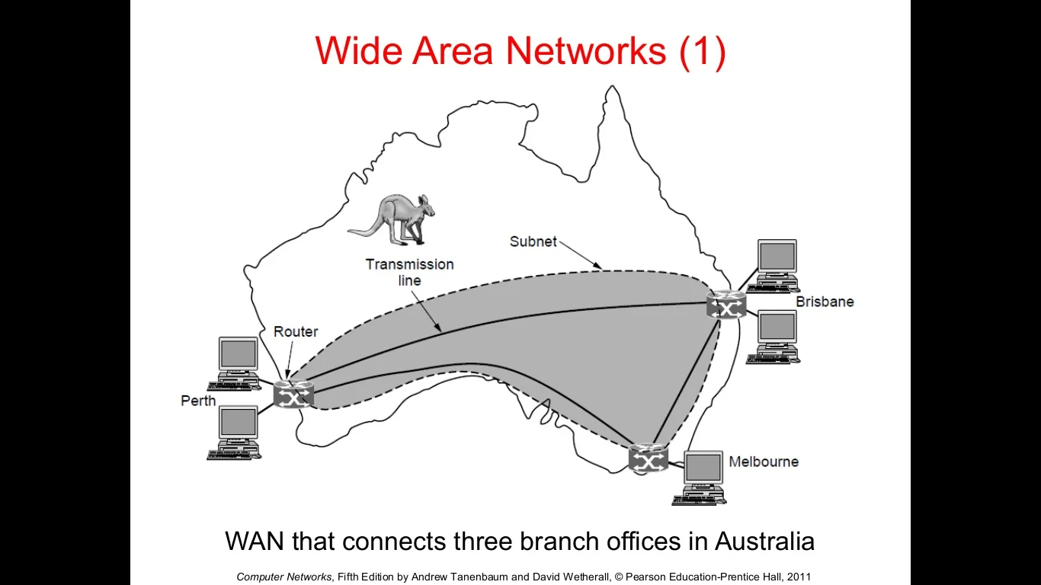
Network Hardware(Contd..)

Slide 33
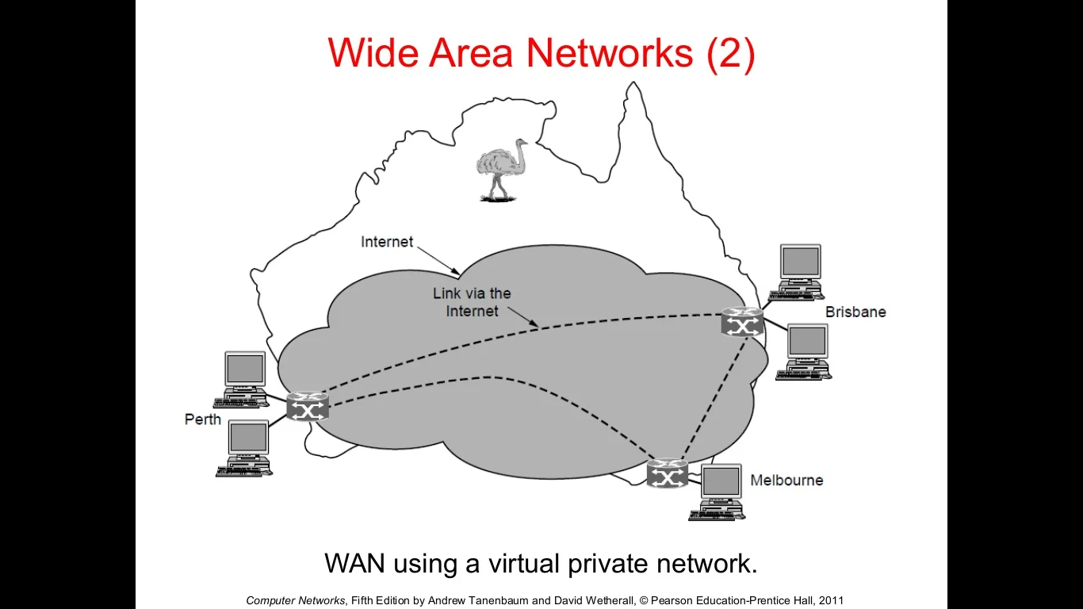
Network Hardware(Contd..)

Slide 34
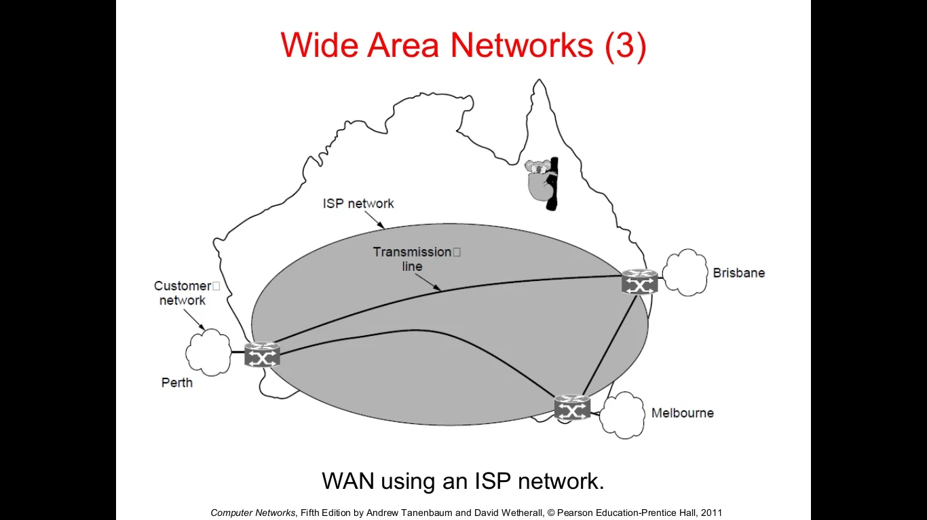
Network Hardware(Contd..)

Slide 35
Network Hardware(Contd..)
Internetworks:
A collection of interconnected networks is called an internetwork or internet.
The Internet uses ISP networks to connect enterprise networks, home networks, and many other networks.

Slide 36
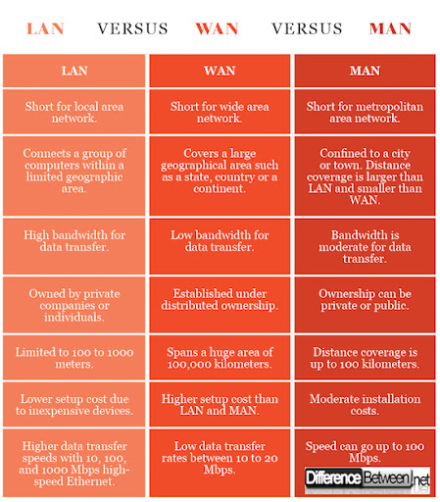

Slide 37
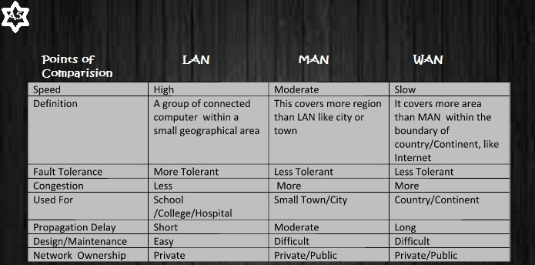

Slide 38
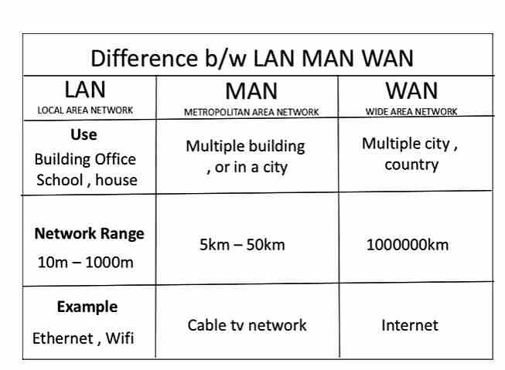

Slide 39
Network Topologies
Logical layout of wires and equipment is called topology.
Topology: Shape of the network
The way in which devices are interconnected to form a network is called network topology.
Some of the factors that affect choice of topology for a network are
Cost
Scalability
Flexibility
Reliability
Ease of installation
Ease of maintenance

Slide 40
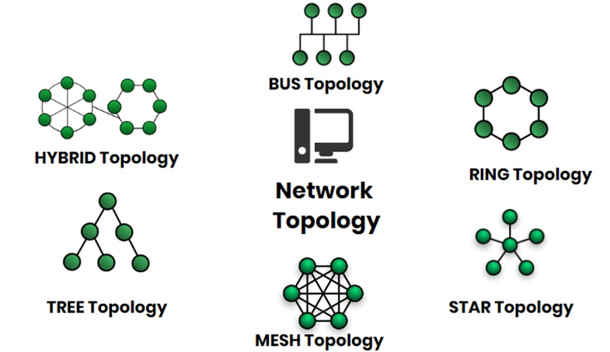

Slide 41
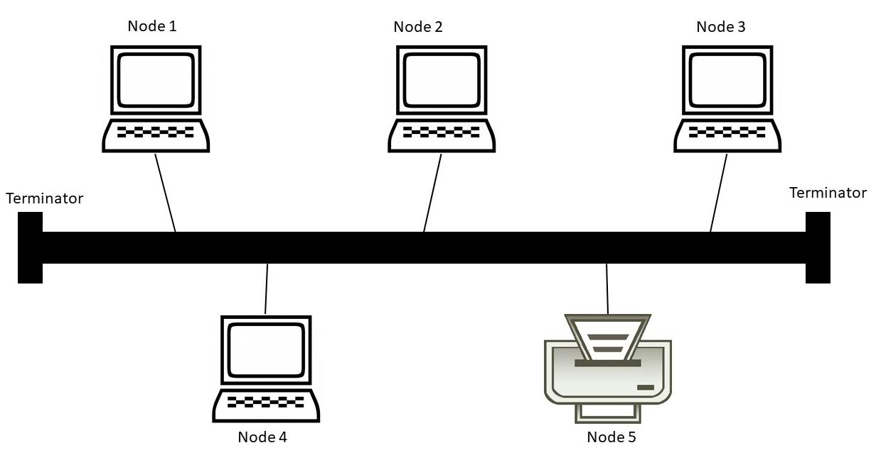
Bus Topology
It is also called linear bus
One wire connects all nodes
Advantages:
Easy to setup
Require less hardware
Low cost
Disadvantages:
Slow
Easy to crash
If one system effected remaining systems cannot communicate with each other

Slide 42
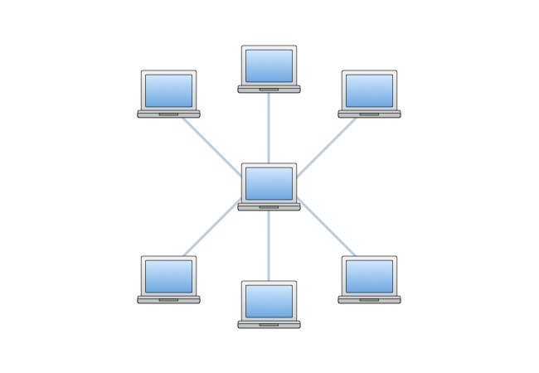
Star Topology
A star topology is a topology for a
Local Area Network (LAN) in which server
is connected to each node individually.
Server is also called the central node.
Any exchange of data between two nodes
must take place through the server.
Advantages
Failure of one node does not affect the network
Troubleshooting is easy as faulty node can be detected from central node immediately

Slide 43
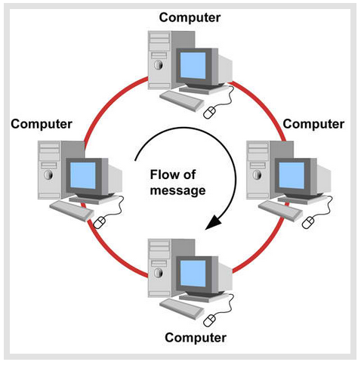
Ring Topology
In ring topology each terminal is connected to
exactly two nodes, giving the network a
circular shape.
Data travels in only one pre-determined direction.
Advantages:
Very high transmission speeds possible
Small cable segments are needed to connect two
nodes
Disadvantages :
Failure of single node brings down the whole network
Troubleshooting is difficult as many nodes may have to be inspected before faulty one is identified
Difficult to remove one or more nodes while keeping the rest of the network intact

Slide 44
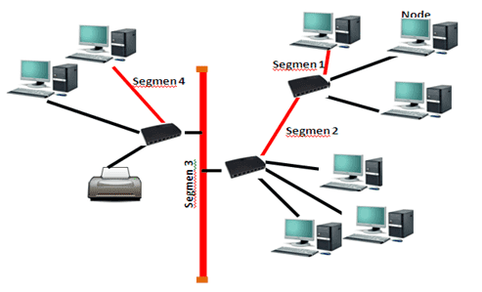
Tree Topology
Tree topology has a group of star networks
connected to a linear bus backbone cable.
It incorporates features of both star and bus
topologies.
Tree topology is also called hierarchical topology.
Advantages
Existing network can be easily expanded
Easier installation and maintenance
Well suited for temporary networks
Disadvantages
Failure of backbone cable brings down entire network
Insecure network
Maintenance difficult for large networks

Slide 45
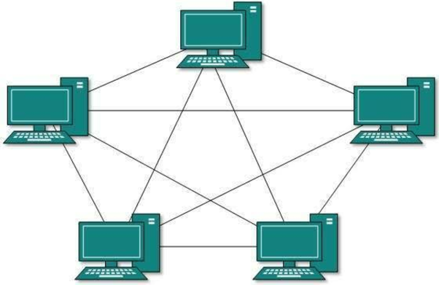
Mesh Topology
In this type of topology, a host is connected to one or multiple hosts.
This topology has hosts in point-to-point connection with every other host
It provides the most reliable network structure among all network topologies.

Slide 46
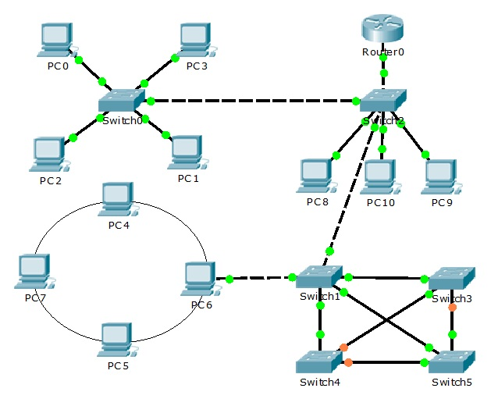
Hybrid Topology
It is the combination of two or more
different topologies.
Advantages:
It is extremely flexible.
It is very reliable.
Error detecting and troubleshooting
are easy.
Handles a large volume of traffic.
It is used to create large networks.
Disadvantages:
It is a type of network expensive.
The design of a hybrid network is very complex.
There is a change in the hardware to connect one topology with another topology.

Slide 47
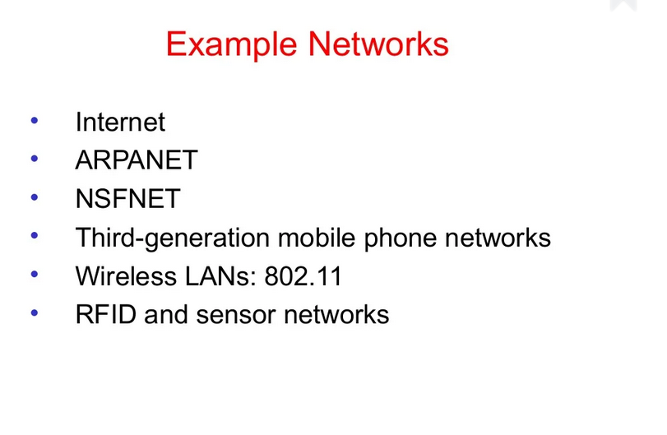

Slide 48
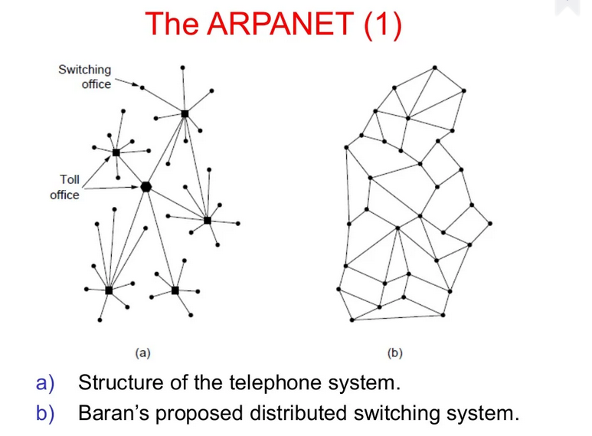

Slide 49
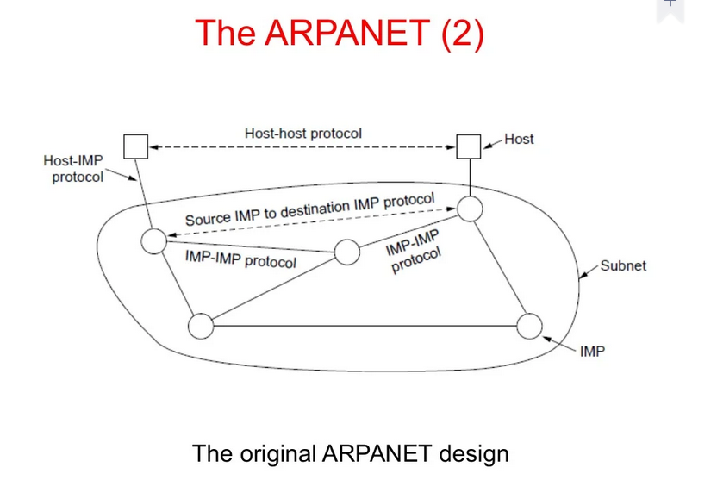

Slide 50
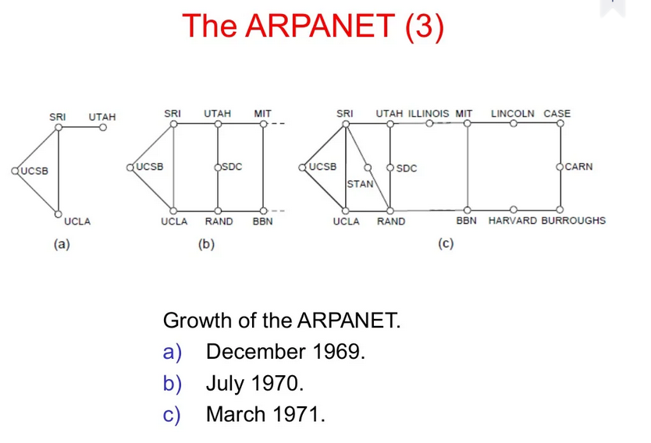

Slide 51
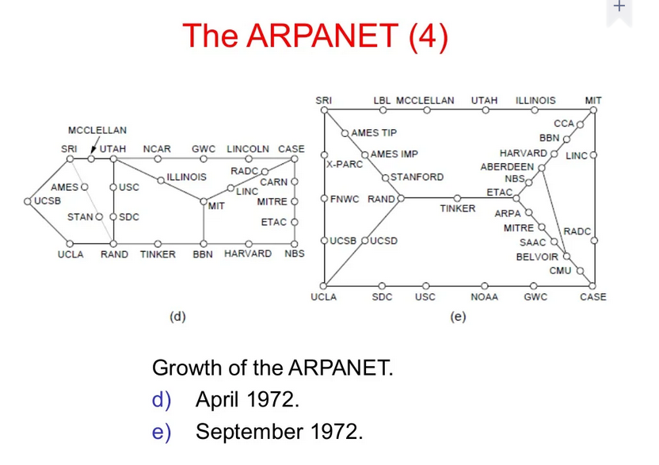

Slide 52
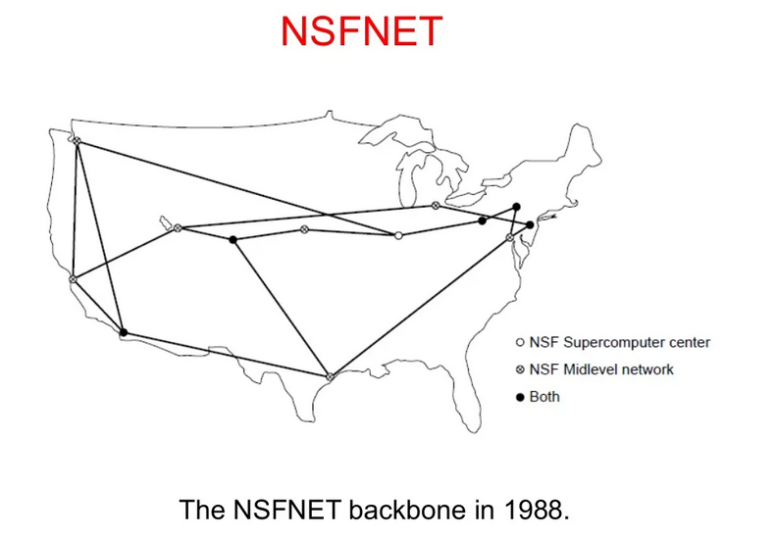

Slide 53
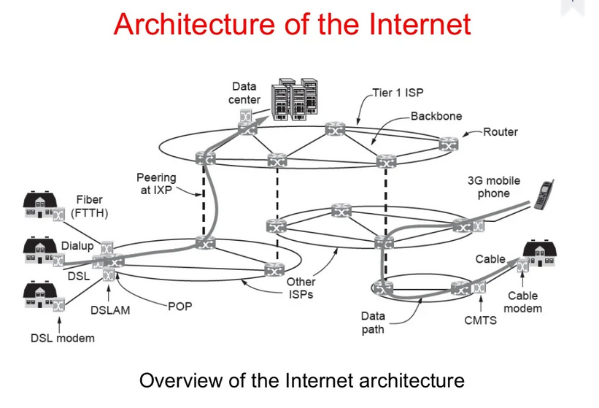

Slide 54
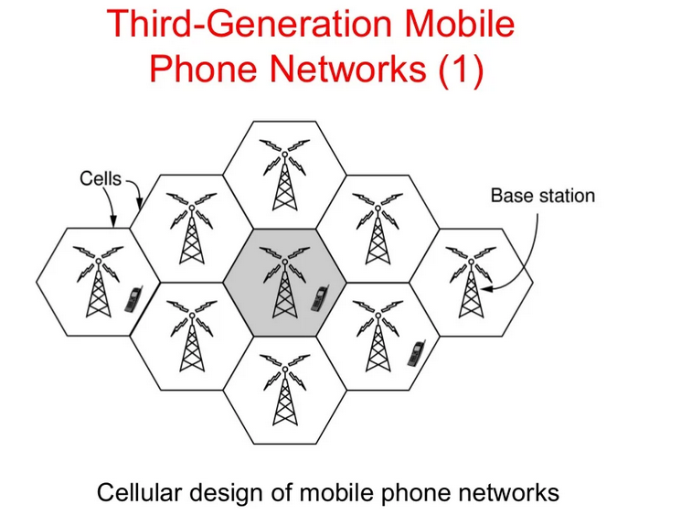

Slide 55
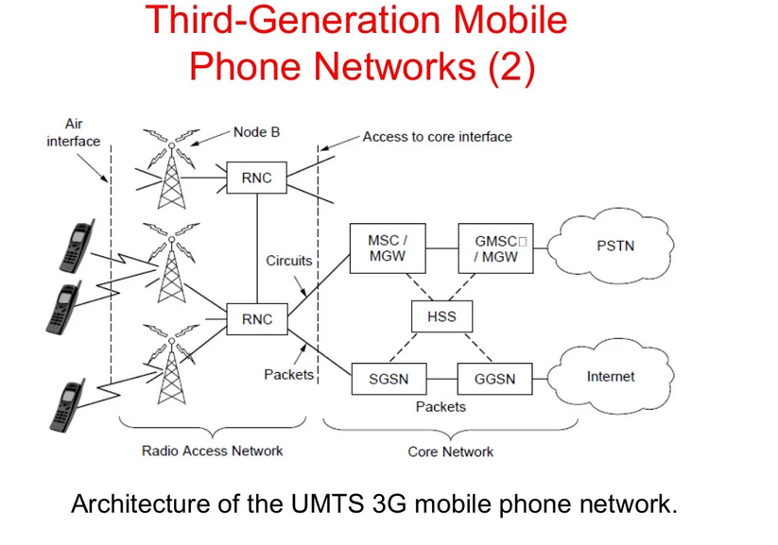

Slide 56
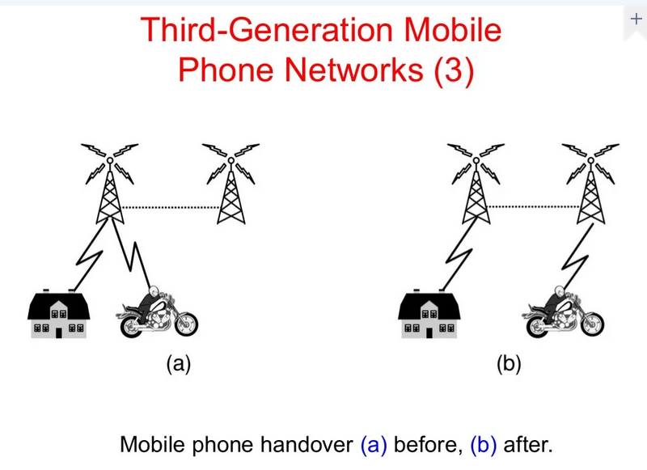

Slide 57
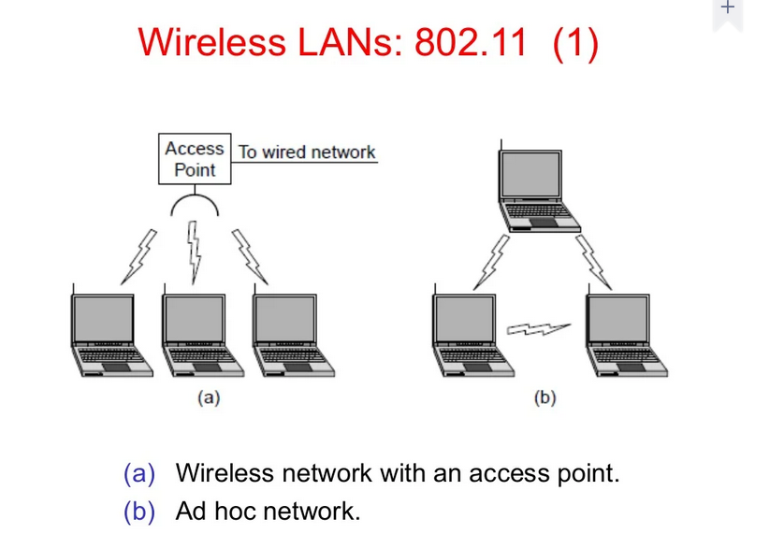

Slide 58
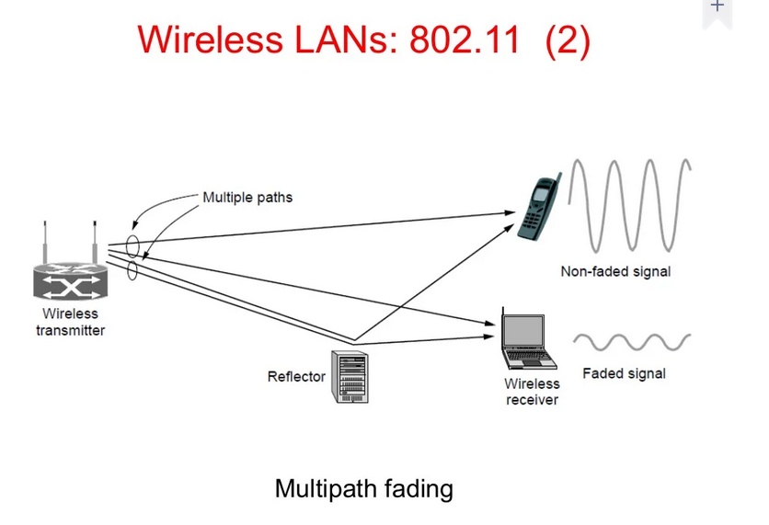

Slide 59
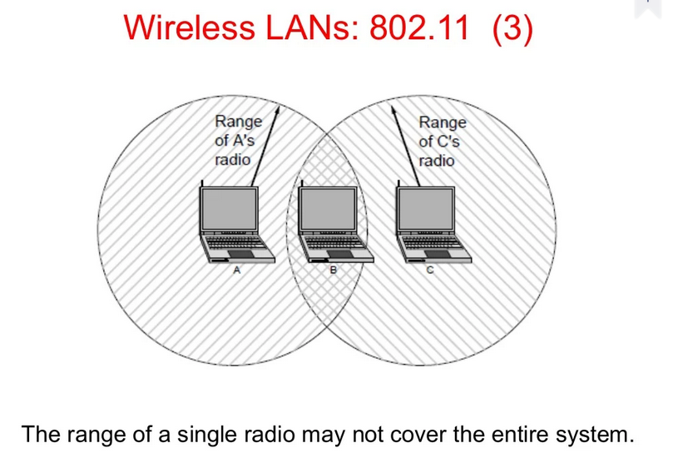

Slide 60
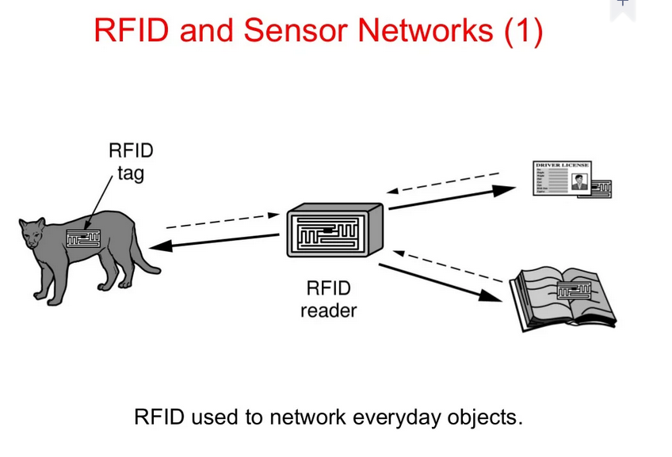

Slide 61
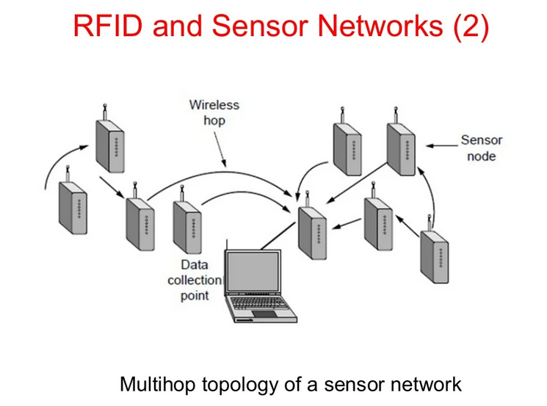

Slide 62
Internet-based Applications
Internet Applications can be described as the type of applications that use the internet for operating successfully.
Some of the popular services of the internet are:
E-mail: Sending and receiving mail electronically.
File Transfer: Transferring files from one computer to another.
WWW (World Wide Web): Retrieving information residing on the internet servers in the form of websites.
Chat: Exchanging views or communicating information instantly.

Slide 63
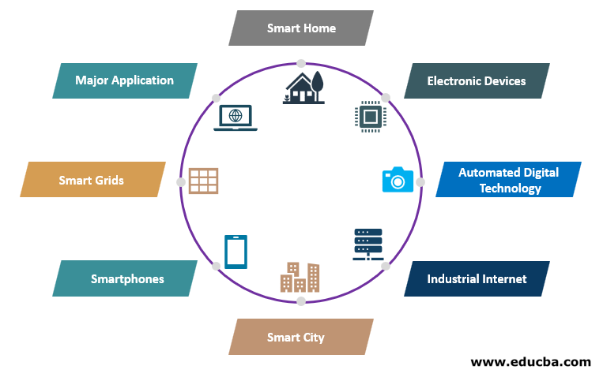
Internet-based Applications

Slide 64
What are network devices?
Network devices, or networking hardware, are physical devices that are required for communication and interaction between hardware on a computer network.
Types of network devices
Repeater
Hub
Bridge
Switch
Router
Gateway
Modem
Wireless Access Point

Slide 65
Repeater
A repeater operates at the physical layer.
Its job is to regenerate the signal over the same network before the signal becomes too weak or corrupted so as to extend the length to which the signal can be transmitted over the same network.
An important point to be noted about repeaters is that they do not amplify the signal. When the signal becomes weak, they copy the signal bit by bit and regenerate it at the original strength. It is a 2 port device.

Slide 66
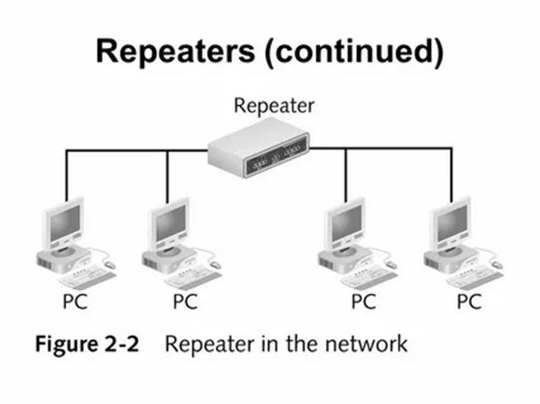
Repeater

Slide 67
Repeater
Repeaters are used for several different reasons:
To extend the network by increasing the distance between nodes (the devices connected together).
To increase overall performance by reducing latencies through shorter transmission distances.
To overcome physical limitations caused by interference or other problems within the medium itself.

Slide 68
Hub
A hub is basically a multiport repeater.
A hub connects multiple wires coming from different branches, for example, the connector in star topology which connects different stations.
Hubs cannot filter data, so data packets are sent to all connected devices.
Also, they do not have the intelligence to find out the best path for data packets which leads to inefficiencies and wastage.

Slide 69
Hub
Types of Network HUB
Passive Hub
Active Hub
Intelligent Hub
Passive Hub: Passive Hub does not require power as they do not regenerate the received signal before forwarding.
Active Hub: Regenerate the received signal before forwarding it to all the ports. So, the active hub needs a power supply. The small workgroup hubs normally use an external power adapter, but on larger units, the power supply is built in.

Slide 70
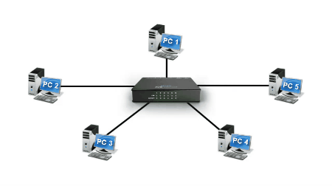
Hub
Intelligent Hub: Provides additional features to the active hub. Also known as a manageable hub, as each port on the hub can be configured by the network operator according to the network requirement. All the ports of the hub can be configured, monitored, enable or disable.

Slide 71
Bridge
A bridge operates at the data link layer.
A bridge is a repeater, with add on the functionality of filtering content by reading the MAC addresses of source and destination.
It is also used for interconnecting two LANs working on the same protocol.
It has a single input and single output port, thus making it a 2 port device.

Slide 72
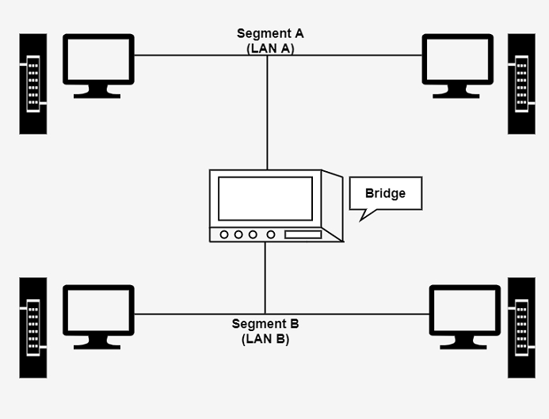
Bridge

Slide 73
Bridge
A bridge performs in the following aspect
A bridge receives all the packets or frame from both LAN (segment) A and B.
A bridge builds a table of addresses from which it can identify that the packets are sent from which LAN (or segment) to which LAN.
Since they operate at data link layer, they transmit data as data frames. On receiving a data frame, the bridge consults a database to decide whether to pass, transmit or discard the frame.
If the frame has a destination MAC (media access control) address in the same network, the bridge passes the frame to that node and then discards it.
If the frame has a destination MAC address in a connected network, it will forward the frame to it.

Slide 74
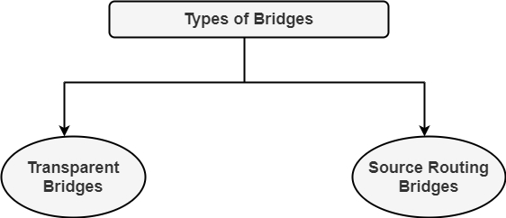
Bridge
Transparent Bridges
Transparent bridge automatically maintains a routing table and update table in response to maintain changing topology. Transparent bridge mechanism consists of three mechanisms:
Frame forwarding
2. Address Learning
Loop Resolution
Transparent bridge is easy to use, install the bridge and no software changes are needed in hosts. In all the cases, transparent bridge flooded the broadcast and multicast frames.
Source Routing Bridge
Source routing bridge decides the route between two hosts. Source routing bridge uses the MAC destination address of a frame to direct it by the source routing algorithm. In source routing, the route over which the frame is to send is Known to every station on the extended LAN. The routing information is stored in the frames.

Slide 75
Bridge
Uses of Bridges
Bridges are used to divide large busy networks into multiple smaller and interconnected networks to improve performance.
Bridges also can increase the physical size of a network.
Bridges are also used to connect a LAN segment through a synchronous modem relation to another LAN segment at a remote area.

Slide 76
Switch
Switches are networking devices operating at layer 2 or a data link layer of the OSI model.
They connect devices in a network and use packet switching to send, receive or forward data packets or data frames over the network.
A switch has many ports, to which computers are plugged in. When a data frame arrives at any port of a network switch, it examines the destination address, performs necessary checks and sends the frame to the corresponding device(s).
It supports unicast, multicast as well as broadcast communications.

Slide 77
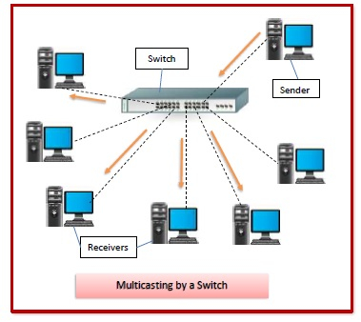
Switch

Slide 78
Router
A Router is a networking device that forwards data packets between computer networks.
Let us understand this by a very general example, suppose you search for www.google.com in your web browser then this will be a request which will be sent from your system to the Google's server to serve that webpage, now your request which is nothing but a stream of packets don`t just go the Google's server straightaway they go through a series of networking devices known as a router which accepts this packets and forwards them to correct path and hence it reaches to the destination server.

Slide 79
Router
Features of Routers
A router is a layer 3 or network layer device.
It connects different networks together and sends data packets from one network to another.
A router can be used both in LANs (Local Area Networks) and WANs (Wide Area Networks).
It transfers data in the form of IP packets. In order to transmit data, it uses IP address mentioned in the destination field of the IP packet.
Routers have a routing table in it that is refreshed periodically according to the changes in the network. In order to transmit data packets, it consults the table and uses a routing protocol.
In order to prepare or refresh the routing table, routers share information among each other.
Routers are more expensive than other networking devices like hubs, bridges and switches.
Routers are manufactured by some popular companies like
Cisco
D-Link
HP
3Com
Juniper
Nortel

Slide 80
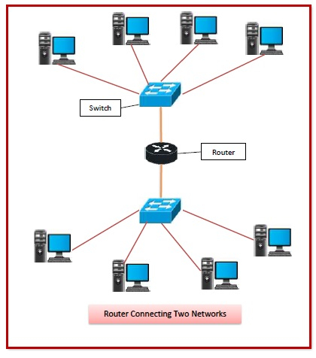
Router

Slide 81
Gateway
A gateway is a network node used in telecommunications that connects two networks with different transmission protocols together.
Gateways serve as an entry and exit point for a network as all data must pass through or communicate with the gateway prior to being routed.
The primary advantage of using a gateway in personal or enterprise scenarios is simplifying internet connectivity into one device.
In the enterprise, a gateway node can also act as a proxy server and a firewall.

Slide 82
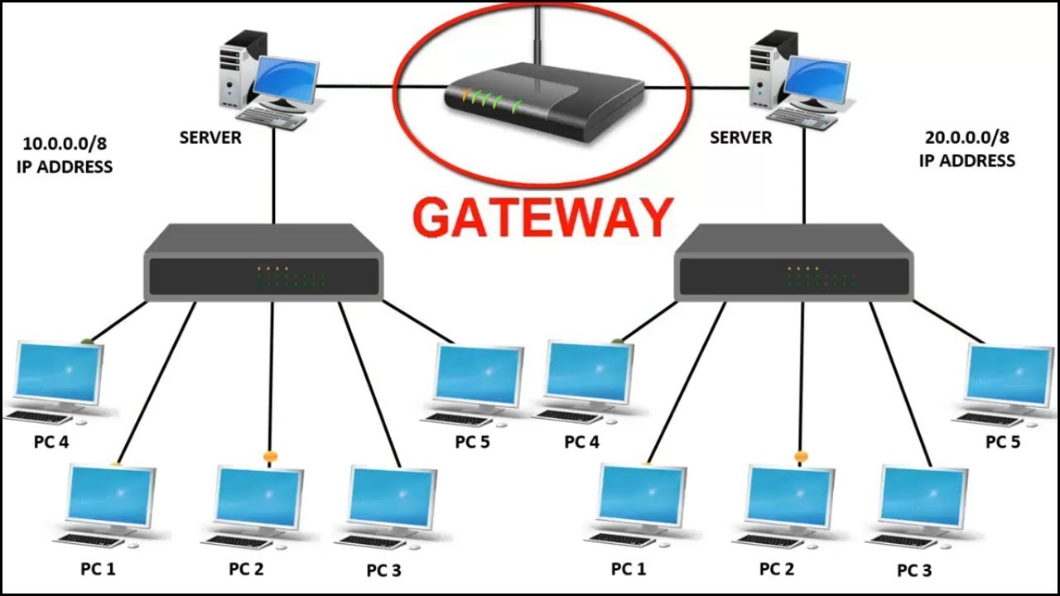
Gateway
The gateway is a computer system which is responsible for routing the traffic from the main workstation to outside network.
For homes, it is responsible for giving the access to the internet thus acting as an internet service provider.

Slide 83
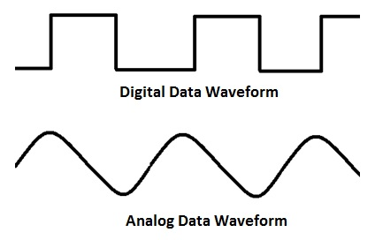
Modem
Modem is a device that enables a computer to send or receive data over telephone or cable lines.
The data stored on the computer is digital whereas a telephone line or cable wire can transmit only analog data.

Slide 84
Modem
The main function of the modem is to convert digital signal into analog and vice versa. Modem is a combination of two devices − modulator and demodulator.
The modulator converts digital data into analog data when the data is being sent by the computer.
The demodulator converts analog data signals into digital data when it is being received by the computer.

Slide 85
Modem
Types of Modem
Modem can be categorized in several ways like direction in which it can transmit data, type of connection to the transmission line, transmission mode, etc.
Depending on direction of data transmission, modem can be of these types
Simplex − A simplex modem can transfer data in only one direction, from digital device to network (modulator) or network to digital device (demodulator).
Half duplex − A half-duplex modem has the capacity to transfer data in both the directions but only one at a time.
Full duplex − A full duplex modem can transmit data in both the directions simultaneously.

Slide 86
Wireless Access Point
A Wireless Access Point (WAP) is a networking device that allows connecting the devices with the wired network.
A Wireless Access Point (WAP) is used to create the WLAN (Wireless Local Area Network), it is commonly used in large offices and buildings which have expanded businesses.
It is easier and simpler to understand and implant the device. It can be fixed, mobile or hybrid proliferated in the 21st century. The availability, confidentiality, and integrity of the communication and network are a responsibility and to be ensured about that.
A wireless AP connects the wired networks to the wireless client. It eases access to the network for mobile users which increases productivity and reduces the infrastructure cost.

Slide 87
Wireless Access Point
It is a device that creates a WLAN (Wireless Local Area Network) in large enterprises.
It is used to extend the coverage area of the network so that it can’t disconnect which allows more users to connect to the network easily.
An access point connects a switch, Ethernet cable, wired router, and Wi-fi to designate the particular area.
It is used to provide connectivity to the users in large offices or enterprises which allows users to roam easily anywhere in the office and be connected to a network.
LANs can also be provided in public places such as coffee shops, restaurants, airports, etc.

Slide 88
Wireless Access Point
Advantages of Wireless Access Point (WAP):
1.More User Access
2.Broader Transmission Range
3.Flexible Networking
Disadvantages of Wireless Access Point (WAP):
1.High Cost
2.Poor Stability
3.Less Secure

Slide 89
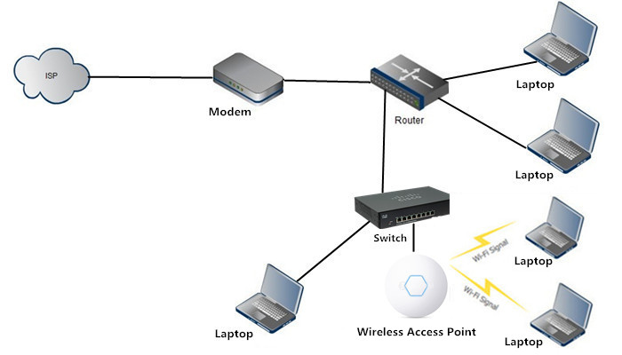
Wireless Access Point

Slide 90
NIC
Network Interface Card (NIC) is a hardware component that is present on the computer.
It is used to connect different networking devices such as computers and servers to share data over the connected network.
It provides functionality such as support for I/O interrupt, Direct Memory Access (DMA) interfaces, partitioning, and data transmission.
NIC is important for us to establish a wired or wireless connection over the network.

Slide 91
NIC
Network Interface Card is also known as Network Interface Controller, Network Adapter, Ethernet card, Connection card, and LAN (Local Area Network) Adapter.
A list of functions of the Network Interface Card is given below
NIC is used to convert data into a digital signal.
In the OSI model, NIC uses the physical layer to transmit signals and the network layer to transmit data packets.
NIC offers both wired (using cables) and wireless (using Wi-Fi) data communication techniques.
NIC is a middleware between a computer/server and a data network.
NIC operates on both physical as well as the data link layer of the OSI model.

Slide 92
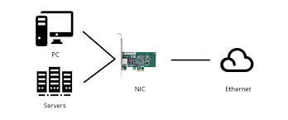
NIC

Slide 93
NIC
Types of Network Interface Cards
1. Ethernet NIC
Ethernet NIC was developed by Robert Metcalf in 1980. It is made by Ethernet cables. This type of NIC is most widely used in the LAN, MAN, and WAN networks.
Example: TP-LINK TG-3468 Gigabit PCI Express Network Adapter.
2. Wireless Networks NIC
It is a wireless network that allows us to connect the devices without using the cables. These types of NICs are used to design a Wi-Fi connection.
Example: Intel 3160 Dual-Band Wireless Adapter

Slide 94
Firewalls
Network Firewalls are the devices that are used to prevent private networks from unauthorized access.
A Firewall is a security solution for the computers or devices that are connected to a network, they can be either in form of hardware as well as in form of software.
It monitors and controls the incoming and outgoing traffic (the amount of data moving across a computer network at any given time ).

Slide 95
Firewalls
The major purpose of the network firewall is to protect an inner network by separating it from the outer network.
Inner Network can be simply called a network created inside an organization and a network that is not in the range of inner network can be considered as Outer Network.

Slide 96
Firewalls
Advantages of Network Firewall :
Monitors Network Traffic A network firewall monitors and analyzes traffic by inspecting whether the traffic or packets passing through our network is safe for our network or not. By doing so, it keeps our network away from any malicious content that can harm our network.
Halt Hacking In a society where everyone is connected to technology, it becomes more important to keep firewalls in our network and use the internet safely.
Stops viruses Viruses can come from anywhere, such as from an insecure website, from a spam message, or any threat, so it becomes more important to have a strong defense system (i.e. firewall in this case), a virus attack can easily shut off a whole network. In such a situation, a firewall plays a vital role.

Slide 97
Firewalls
4.Better security If it is about monitoring and analyzing the network from time to time and establishing a malware-free, virus-free, spam-free environment so network firewall will provide better security to our network.
5. Increase privacy By protecting the network and providing better security, we get a network that can be trusted.

Slide 98
Firewalls
Disadvantages of Network Firewall :
Cost Depending on the type of firewall, it can be costly, usually, the hardware firewalls are more costly than the software ones.
Restricts User Restricting users can be a disadvantage for large organizations, because of its tough security mechanism. A firewall can restrict the employees to do a certain operation even though it’s a necessary operation.
Issues with the speed of the network Since the firewalls have to monitor every packet passing through the network, this can slow down operations needed to be performed, or it can simply lead to slowing down the network.
Maintenance Firewalls require continuous updates and maintenance with every change in the networking technology. As the development of new viruses is increasing continuously that can damage your system.

Slide 99
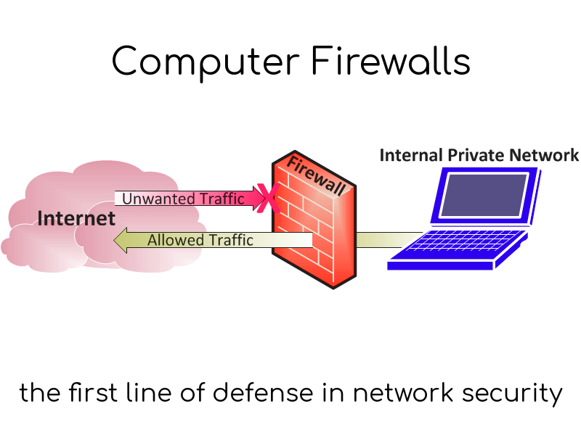
Firewalls

Slide 100
Proxies
Proxy server refers to a server that acts as an intermediary between the request made by clients, and a particular server for some services or requests for some resources.
There are different types of proxy servers available that are put into use according to the purpose of a request made by the clients to the servers.
The basic purpose of Proxy servers is to protect the direct connection of Internet clients and internet resources.
The proxy server also prevents the identification of the client’s IP address when the client makes any request is made to any other servers.

Slide 101
Proxies
How Does The Proxy Server Operates?
Every computer has its unique IP address which it uses to communicate with another node. Similarly, the proxy server has its IP address that your computer knows.
When a web request is sent, your request goes to the proxy server first. The Proxy sends a request on your behalf to the internet and then collect the data and make it available to you.
A proxy can change your IP address So, the webserver will be unable to fetch your location in the world. It protects data from getting hacked too. Moreover, it can block some web pages also.

Slide 102

Proxies

Slide 103
Proxies
Disadvantages of Proxy Server
Proxy Server Risks:
Free installation does not invest much in backend hardware or encryption. It will result in performance issues and potential data security issues. If you install a “free” proxy server, treat very carefully, some of those might steal your credit card numbers.
2.Browsing history log:
The proxy server stores your original IP address and web request information is possibly unencrypted form and saved locally. Always check if your proxy server logs and saves that data and what kind of retention or law enforcement cooperation policies they follow while saving data.

Slide 104
Proxies
3.No encryption:
No encryption means you are sending your requests as plain text. Anyone will be able to pull usernames and passwords and account information easily. Keep a check that proxy provides full encryption whenever you use it.

Slide 105
Differences b/w Firewall and Proxy Server
BASIS FOR COMPARISON | FIREWALL | PROXY SERVER
Basic | Monitors and filters the incoming and outgoing traffic in a local network. | Establishes the communication between the external client and the server.
Filters | IP packets | Client-side requests for the connection.
Generated overhead | More | Less
Involves | Network and Transport layer data. | Application layer data.

Slide 106
Protocol Layering
A protocol is a set of rules and standards that primarily outline a language that devices will use to communicate.
It provides a communication service where the process is used to exchange the messages. When the communication is simple, we can use only one simple protocol.
When the communication is complex, we must divide the task between different layers, so, we need to follow a protocol at each layer, this technique we used to call protocol layering. This layering allows us to separate the services from the implementation.
Each layer needs to receive a set of services from the lower layer and to give the services to the upper layer. The modification done in any one layer will not affect the other layers.

Slide 107
The basic elements of the layered architecture are as follows −
Service − Set of actions or services provided from one layer to the higher layer.
Protocol − It defines a set of rules where a layer uses to exchange the information with its peer entity. It is concerned about both the contents and order of the messages used.
Interface − It is a way through that the message is transferred from one layer to another layer.

Slide 108
The reasons for using layered protocols are explained below −
Layering of protocols provides well-defined interfaces between the layers, so that a change in one layer does not affect an adjacent layer.
The protocols of a network are extremely complicated and designing them in layers makes their implementation more feasible.

Slide 109
The advantages of layered protocols are as follows −
Assists in protocol style, as a result of protocols that operate at a particular layer have outlined information that they work and a defined interface to the layers on top of and below.
Prevents technology or capability changes in one layer from touching different layers above and below.
Provides a typical language to explain networking functions and capabilities.

Slide 110
The disadvantages of layered protocols are as follows −
The main disadvantages of layered systems consist primarily of overhead each in computation and in message headers caused by the abstraction barriers between layers.
The upper-level layers cannot see what is within the lower layers, implying that an application cannot correct where in an exceedingly connection a problem is or precisely what the matter is.
The higher-level layers cannot control all aspects of the lower layers, so that they cannot modify the transfer system if helpful (like controlling windowing, header compression, CRC/parity checking, et cetera), nor specify routing, and should rely on the lower protocols operating, and cannot specify alternatives when there are issues.

Slide 111

Protocol Hierarchies
Layers,
Important that each
layer perform specific
actions.
protocols,
Interfaces
Defines the services
That one layer offers
another (either up
or down.)

Slide 112
Reference Models (1)
There are two competing models for how the software is layered. These are the OSI and the TCP models.
OSI (Open Systems Interconnection)
Developed by ISO (International Standards Organization)
7 layers
TCP (Transfer Control Protocol)
Used in the Arpanet and in the Internet. Common mechanism that is surpassing the OSI Model.
4 layers

Slide 113

Reference Models (2)

Slide 114
OSI Reference Model (1)
Principles used to develop OSI Layering:
1. Need a layer for each different level of abstraction.
2. Each layer performs a well defined function.
3. Each layer should be standardizable.
4. Layer boundaries should minimize data flow across those boundaries.
5. The right number of layers - don't put too many functions together, but not too many layers either.

Slide 115

OSI Reference Model (2)

Slide 116
Physical Layer (Layer 1)
The lowest layer of the OSI reference model is the physical layer. It is responsible for the actual physical connection between the devices.
The physical layer contains information in the form of bits. It is responsible for transmitting individual bits from one node to the next.
When receiving data, this layer will get the signal received and convert it into 0s and 1s and send them to the Data Link layer, which will put the frame back together.

Slide 117
Physical Layer (Layer 1)
The functions of the physical layer are as follows:
Bit synchronization: The physical layer provides the synchronization of the bits by providing a clock. This clock controls both sender and receiver thus providing synchronization at bit level
Bit rate control: The Physical layer also defines the transmission rate i.e. the number of bits sent per second.
Physical topologies: Physical layer specifies the way in which the different, devices/nodes are arranged in a network i.e. bus, star, or mesh topology.
Transmission mode: Physical layer also defines the way in which the data flows between the two connected devices. The various transmission modes possible are Simplex, half-duplex and full-duplex.

Slide 118
Physical Layer (Layer 1)
Hub, Repeater, Modem, Cables are Physical Layer devices.
Network Layer, Data Link Layer, and Physical Layer are also known as Lower Layers or Hardware Layers.

Slide 119
Data Link Layer (DLL) (Layer 2)
The data link layer is responsible for the node-to-node delivery of the message.
The main function of this layer is to make sure data transfer is error-free from one node to another, over the physical layer.
When a packet arrives in a network, it is the responsibility of DLL to transmit it to the Host using its MAC address.

Slide 120
Data Link Layer (DLL) (Layer 2)
Data Link Layer is divided into two sub layers:
1.Logical Link Control (LLC)
2.Media Access Control (MAC)
The packet received from the Network layer is further divided into frames depending on the frame size of NIC(Network Interface Card). DLL also encapsulates Sender and Receiver’s MAC address in the header.
The Receiver’s MAC address is obtained by placing an ARP(Address Resolution Protocol) request onto the wire asking “Who has that IP address?” and the destination host will reply with its MAC address.

Slide 121
Data Link Layer (DLL) (Layer 2)
The functions of the Data Link layer are :
Framing: Framing is a function of the data link layer. It provides a way for a sender to transmit a set of bits that are meaningful to the receiver. This can be accomplished by attaching special bit patterns to the beginning and end of the frame.
Physical addressing: After creating frames, the Data link layer adds physical addresses (MAC address) of the sender and/or receiver in the header of each frame.
Error control: Data link layer provides the mechanism of error control in which it detects and retransmits damaged or lost frames.
Flow Control: The data rate must be constant on both sides else the data may get corrupted thus, flow control coordinates the amount of data that can be sent before receiving acknowledgement.
Access control: When a single communication channel is shared by multiple devices, the MAC sub-layer of the data link layer helps to determine which device has control over the channel at a given time.

Slide 122
Data Link Layer (DLL) (Layer 2)
Packet in Data Link layer is referred to as Frame.
Data Link layer is handled by the NIC (Network Interface Card) and device drivers of host machines.
Switch & Bridge are Data Link Layer devices.

Slide 123
Network Layer (Layer 3)
The network layer works for the transmission of data from one host to the other located in different networks.
It also takes care of packet routing i.e. selection of the shortest path to transmit the packet, from the number of routes available. The sender & receiver’s IP addresses are placed in the header by the network layer.

Slide 124
Network Layer (Layer 3)
The functions of the Network layer are :
Routing: The network layer protocols determine which route is suitable from source to destination. This function of the network layer is known as routing.
Logical Addressing: In order to identify each device on internetwork uniquely, the network layer defines an addressing scheme. The sender & receiver’s IP addresses are placed in the header by the network layer. Such an address distinguishes each device uniquely and universally.
Segment in Network layer is referred to as Packet.
Network layer is implemented by networking devices such as routers.

Slide 125
Transport Layer (Layer 4)
The transport layer provides services to the application layer and takes services from the network layer. The data in the transport layer is referred to as Segments.
It is responsible for the End to End Delivery of the complete message. The transport layer also provides the acknowledgement of the successful data transmission and re-transmits the data if an error is found.
At sender’s side: Transport layer receives the formatted data from the upper layers, performs Segmentation, and also implements Flow & Error control to ensure proper data transmission. It also adds Source and Destination port numbers in its header and forwards the segmented data to the Network Layer.
Note: The sender needs to know the port number associated with the receiver’s application.

Slide 126
Transport Layer (Layer 4)
Generally, this destination port number is configured, either by default or manually. For example, when a web application makes a request to a web server, it typically uses port number 80, because this is the default port assigned to web applications. Many applications have default ports assigned.
At receiver’s side: Transport Layer reads the port number from its header and forwards the Data which it has received to the respective application. It also performs sequencing and reassembling of the segmented data.
The functions of the transport layer are as follows:
Segmentation and Reassembly: This layer accepts the message from the (session) layer, and breaks the message into smaller units. Each of the segments produced has a header associated with it. The transport layer at the destination station reassembles the message.

Slide 127
Transport Layer (Layer 4)
Service Point Addressing: In order to deliver the message to the correct process, the transport layer header includes a type of address called service point address or port address. Thus by specifying this address, the transport layer makes sure that the message is delivered to the correct process.
The services provided by the transport layer :
A. Connection-Oriented Service
B. Connectionless service
Data in the Transport Layer is called as Segments.
Transport layer is operated by the Operating System. It is a part of the OS and communicates with the Application Layer by making system calls.
Transport Layer is called as Heart of OSI model.

Slide 128
Session Layer (Layer 5)
This layer is responsible for the establishment of connection, maintenance of sessions, authentication, and also ensures security.
The functions of the session layer are :
Session establishment, maintenance, and termination: The layer allows the two processes to establish, use and terminate a connection.
Synchronization: This layer allows a process to add checkpoints which are considered synchronization points into the data. These synchronization points help to identify the error so that the data is re-synchronized properly, and ends of the messages are not cut prematurely and data loss is avoided.
Dialog Controller: The session layer allows two systems to start communication with each other in half-duplex or full-duplex.

Slide 129

Session Layer (Layer 5)
Scenario:
Let us consider a scenario where a user wants to send a message through some Messenger application running in his browser.
The “Messenger” here acts as the application layer which provides the user with an interface to create the data. This message or so-called Data is compressed, encrypted (if any secure data), and converted into bits (0’s and 1’s) so that it can be transmitted.

Slide 130
Presentation Layer (Layer 6)
The presentation layer is also called the Translation layer. The data from the application layer is extracted here and manipulated as per the required format to transmit over the network. The functions of the presentation layer are :
Translation: For example, ASCII to EBCDIC.
Encryption/ Decryption: Data encryption translates the data into another form or code. The encrypted data is known as the cipher text and the decrypted data is known as plain text. A key value is used for encrypting as well as decrypting data.
Compression: Reduces the number of bits that need to be transmitted on the network.

Slide 131
Application Layer (Layer 7)
At the very top of the OSI Reference Model stack of layers, we find the Application layer which is implemented by the network applications.
These applications produce the data, which has to be transferred over the network. This layer also serves as a window for the application services to access the network and for displaying the received information to the user.
Example: Application – Browsers, Skype Messenger, etc.
Application Layer is also called Desktop Layer.

Slide 132
Application Layer (Layer 7)
The functions of the Application layer are :
Network Virtual Terminal
FTAM-File transfer access and management
Mail Services
Directory Services

Slide 133

OSI model in a nutshell

Slide 134

Data Transmission in OSI model
Data Transmission in the OSI Model

Slide 135


TCP/IP Reference Model (1)

Slide 136
TCP/IP Reference Model (2)
The TCP/IP model is a concise version of the OSI model. It contains four layers, unlike seven layers in the OSI model.
The layers are:
Process/Application Layer
Host-to-Host/Transport Layer
Internet Layer
Network Access/Link Layer

Slide 137
Network Access Layer
This layer corresponds to the combination of Data Link Layer and Physical Layer of the OSI model.
It looks out for hardware addressing and the protocols present in this layer allows for the physical transmission of data.

Slide 138
Internet Layer
It defines the protocols which are responsible for logical transmission of data over the entire network.
The main protocols residing at this layer are :
IP – stands for Internet Protocol and it is responsible for delivering packets from the source host to the destination host by looking at the IP addresses in the packet headers.
ICMP – stands for Internet Control Message Protocol. It is encapsulated within IP datagrams and is responsible for providing hosts with information about network problems.
ARP – stands for Address Resolution Protocol. Its job is to find the hardware address of a host from a known IP address. ARP has several types: Reverse ARP, Proxy ARP, Gratuitous ARP and Inverse ARP.

Slide 139
Host-to-Host Layer
This layer is analogous to the transport layer of the OSI model. It is responsible for end-to-end communication and error-free delivery of data. It shields the upper-layer applications from the complexities of data.
The two main protocols present in this layer are :
Transmission Control Protocol (TCP) – It is known to provide reliable and error-free communication between end systems. It performs sequencing and segmentation of data. It also has acknowledgment feature and controls the flow of the data through flow control mechanism. It is a very effective protocol but has a lot of overhead due to such features. Increased overhead leads to increased cost.
User Datagram Protocol (UDP) – On the other hand does not provide any such features. It is the go-to protocol if your application does not require reliable transport as it is very cost-effective. Unlike TCP, which is connection-oriented protocol, UDP is connectionless.

Slide 140
Application Layer
This layer performs the functions of top three layers of the OSI model: Application, Presentation and Session Layer.
It is responsible for node-to-node communication and controls user-interface specifications.
Some of the protocols present in this layer are: HTTP, HTTPS, FTP, TFTP, Telnet, SSH, SMTP, SNMP, NTP, DNS, DHCP, NFS etc.

Slide 141
Difference between TCP/IP and OSI Model:
TCP/IP | OSI
TCP refers to Transmission Control Protocol. | OSI refers to Open Systems Interconnection.
TCP/IP has 4 layers. | OSI has 7 layers.
TCP/IP is more reliable | OSI is less reliable
TCP/IP does not have very strict boundaries. | OSI has strict boundaries
TCP/IP follow a horizontal approach. | OSI follows a vertical approach.
TCP/IP uses both session and presentation layer in the application layer itself. | OSI uses different session and presentation layers.
TCP/IP developed protocols then model. | OSI developed model then protocol.
Transport layer in TCP/IP does not provide assurance delivery of packets. | In OSI model, transport layer provides assurance delivery of packets.
TCP/IP model network layer only provides connection less services. | Connection less and connection oriented both services are provided by network layer in OSI model.
Protocols cannot be replaced easily in TCP/IP model. | While in OSI model, Protocols are better covered and is easy to replace with the change in technology.

Slide 142
Bandwidth Utilization
Bandwidth, or precisely network bandwidth, is the maximum rate at which data transfer occurs across any particular path of the network. Bandwidth is basically a measure of the amount of data that can be sent and received at any instance of time.
Bandwidth is usually measured in bits transferred per second through a path or link. The common units of bandwidth we come across are as follows.
bps (Bits per second)
Mbps (Megabits per second)
Gbps (Gigabits per second)

Slide 143

Multiplexing
Multiplexing is a technique used to combine and send the multiple data streams over a single medium. The process of combining the data streams is known as multiplexing and hardware used for multiplexing is known as a multiplexer.
Multiplexing is achieved by using a device called Multiplexer (MUX) that combines n input lines to generate a single output line. Multiplexing follows many-to-one, i.e., n input lines and one output line.
Demultiplexing is achieved by using a device called Demultiplexer (DEMUX) available at the receiving end. DEMUX separates a signal into its component signals (one input and n outputs). Therefore, we can say that demultiplexing follows the one-to-many approach.

Slide 144

Advantages of Multiplexing:
More than one signal can be sent over a single medium.
The bandwidth of a medium can be utilized effectively.
Multiplexing Techniques Multiplexing techniques can be classified as:

Slide 145

Frequency-division Multiplexing (FDM)
Frequency Division Multiplexing is a technique in which the available bandwidth of a single transmission medium is subdivided into several channels.
FDM is mainly used in radio broadcasts and TV networks
The main aim of the FDM is to subdivide the available bandwidth into different frequency channels and allocate them to different devices.

Slide 146

Wavelength Division Multiplexing (WDM)
Wavelength Division Multiplexing is same as FDM except that the optical signals are transmitted through the fibre optic cable.
WDM is used on fibre optics to increase the capacity of a single fibre.
It is used to utilize the high data rate capability of fibre optic cable.
It is an analog multiplexing technique.
Optical signals from different source are combined to form a wider band of light with the help of multiplexer.
At the receiving end, demultiplexer separates the signals to transmit them to their respective destinations.
Multiplexing and Demultiplexing can be achieved by using a prism.

Slide 147
Time Division Multiplexing
It is a digital technique.
In Frequency Division Multiplexing Technique, all signals operate at the same time with different frequency, but in case of Time Division Multiplexing technique, all signals operate at the same frequency with different time.
In Time Division Multiplexing technique, the total time available in the channel is distributed among different users. Therefore, each user is allocated with different time interval known as a Time slot at which data is to be transmitted by the sender.
A user takes control of the channel for a fixed amount of time.
In Time Division Multiplexing technique, data is not transmitted simultaneously rather the data is transmitted one-by-one.
In TDM, the signal is transmitted in the form of frames. Frames contain a cycle of time slots in which each frame contains one or more slots dedicated to each user.
It can be used to multiplex both digital and analog signals but mainly used to multiplex digital signals.

Slide 148
1.Synchronous TDM
A Synchronous TDM is a technique in which time slot is preassigned to every device.
In Synchronous TDM, each device is given some time slot irrespective of the fact that the device contains the data or not.
2.Asynchronous TDM
An asynchronous TDM is also known as Statistical TDM.
An asynchronous TDM is a technique in which time slots are not fixed as in the case of Synchronous TDM. Time slots are allocated to only those devices which have the data to send. Therefore, we can say that Asynchronous Time Division multiplexor transmits only the data from active workstations.
An asynchronous TDM technique dynamically allocates the time slots to the devices.

Slide 149

Spectrum Spreading
The increasing demand for wireless communications has problems due to limited spectrum efficiency and multipath propagation. The use of spread spectrum communication has simplified these problems. In the spread spectrum, signals from different sources are combined to fit into larger bandwidth.
Characteristics of the Spread Spectrum are:
Higher channel capacity.
Ability to resist multipath propagation.
They cannot easily intercept any unauthorized person.
They are resistant to jamming.
The spread spectrum provides immunity to distortion due to multipath propagation.
The spread spectrum offers multiple access capabilities.

Slide 150

Types of techniques for Spread Spectrum
Frequency Hopping Spread Spectrum (FHSS)
Direct Sequence Spread Spectrum (DSSS)
Frequency Hopping Spread Spectrum (FHSS):
In Frequency Hopping Spread Spectrum (FHSS), different carrier frequencies are modulated by the source signal i.e. M carrier frequencies are modulated by the signal. At one moment signal modulates one carrier frequency and at the subsequent moments, it modulates other carrier frequencies. The general block diagram of FHSS is shown in the below figure.

Slide 151

Direct Sequence Spread Spectrum (DSSS):
In DSSS, the bandwidth of the original signal is also expanded by a different technique. Here, each data bit is replaced with n bits using a spreading code called chips, and the bit rate of the chip is called as chip-rate. The chip rate is n times the bit rate of the original signal. The below Figure shows the DSSS block diagram.
Figure:Direct Sequence Spread Spectrum

Slide 152
Transmission Media
Transmission media is a communication channel that carries the information from the sender to the receiver. Data is transmitted through the electromagnetic signals.
The main functionality of the transmission media is to carry the information in the form of bits through LAN(Local Area Network).
It is a physical path between transmitter and receiver in data communication.
In a copper-based network, the bits in the form of electrical signals.
In a fibre based network, the bits in the form of light pulses.
In OSI(Open System Interconnection) phase, transmission media supports the Layer 1. Therefore, it is considered to be as a Layer 1 component.
The electrical signals can be sent through the copper wire, fibre optics, atmosphere, water, and vacuum.
The characteristics and quality of data transmission are determined by the characteristics of medium and signal.
Transmission media is of two types are wired media and wireless media. In wired media, medium characteristics are more important whereas, in wireless media, signal characteristics are more important.
Different transmission media have different properties such as bandwidth, delay, cost and ease of installation and maintenance.
The transmission media is available in the lowest layer of the OSI reference model, i.e., Physical layer.

Slide 153

Classification of Transmission Media

Slide 154

Guided Transmission Media
It is defined as the physical medium through which the signals are transmitted. It is also known as Bounded media.
1.Twisted Pair:
Twisted pair is a physical media made up of a pair of cables twisted with each other. A twisted pair cable is cheap as compared to other transmission media. Installation of the twisted pair cable is easy, and it is a lightweight cable. The frequency range for twisted pair cable is from 0 to 3.5KHz.
Types of Twisted pair:

Slide 155
Unshielded Twisted Pair:
An unshielded twisted pair is widely used in telecommunication. Following are the categories of the unshielded twisted pair cable:
Category 1: Category 1 is used for telephone lines that have low-speed data.
Category 2: It can support upto 4Mbps.
Category 3: It can support upto 16Mbps.
Category 4: It can support upto 20Mbps. Therefore, it can be used for long-distance communication.
Category 5: It can support upto 200Mbps.

Slide 156
Advantages Of Unshielded Twisted Pair:
It is cheap.
Installation of the unshielded twisted pair is easy.
It can be used for high-speed LAN.
Disadvantage:
This cable can only be used for shorter distances because of attenuation.

Slide 157
Shielded Twisted Pair:
A shielded twisted pair is a cable that contains the mesh surrounding the wire that allows the higher transmission rate.
Characteristics Of Shielded Twisted Pair:
The cost of the shielded twisted pair cable is not very high and not very low.
An installation of STP is easy.
It has higher capacity as compared to unshielded twisted pair cable.
It has a higher attenuation.
It is shielded that provides the higher data transmission rate.
Disadvantages
It is more expensive as compared to UTP and coaxial cable.
It has a higher attenuation rate.

Slide 158

Coaxial Cable
Coaxial cable is very commonly used transmission media, for example, TV wire is usually a coaxial cable.
The name of the cable is coaxial as it contains two conductors parallel to each other.
It has a higher frequency as compared to Twisted pair cable.
The inner conductor of the coaxial cable is made up of copper, and the outer conductor is made up of copper mesh. The middle core is made up of non-conductive cover that separates the inner conductor from the outer conductor.
The middle core is responsible for the data transferring whereas the copper mesh prevents from the EMI(Electromagnetic interference).
Coaxial cable is of two types:
1.Baseband transmission: It is defined as the process of transmitting a single signal at high speed.
2.Broadband transmission: It is defined as the process of transmitting multiple signals simultaneously.
Advantages Of Coaxial cable:
The data can be transmitted at high speed.
It has better shielding as compared to twisted pair cable.
It provides higher bandwidth.
Disadvantages Of Coaxial cable:
It is more expensive as compared to twisted pair cable.
If any fault occurs in the cable causes the failure in the entire network.

Slide 159

Fibreoptics It uses the concept of refraction of light through a core made up of glass or plastic. The core is surrounded by a less dense glass or plastic covering called the cladding. It is used for the transmission of large volumes of data.
The cable can be unidirectional or bidirectional. The WDM (Wavelength Division Multiplexer) supports two modes, namely unidirectional and bidirectional mode.

Slide 160
Advantages:
Increased capacity and bandwidth
Lightweight
Less signal attenuation
Immunity to electromagnetic interference
Resistance to corrosive materials
Disadvantages:
Difficult to install and maintain
High cost
Applications:
Medical Purpose: Used in several types of medical instruments.
Defence Purpose: Used in transmission of data in aerospace.
For Communication: This is largely used in formation of internet cables.
Industrial Purpose: Used for lighting purposes and safety measures in designing the interior and exterior of automobiles.

Slide 161
Unguided Transmission Media
An unguided transmission transmits the electromagnetic waves without using any physical medium. Therefore it is also known as wireless transmission.
In unguided media, air is the media through which the electromagnetic energy can flow easily.
1.Radiowaves:
Radio waves are the electromagnetic waves that are transmitted in all the directions of free space.
Radio waves are omnidirectional, i.e., the signals are propagated in all the directions.
The range in frequencies of radio waves is from 3Khz to 1 khz.
In the case of radio waves, the sending and receiving antenna are not aligned, i.e., the wave sent by the sending antenna can be received by any receiving antenna.
An example of the radio wave is FM radio.

Slide 162

2.Microwaves:
Characteristics of Microwave:
Frequency range: The frequency range of terrestrial microwave is from 4-6 GHz to 21-23 GHz.
Bandwidth: It supports the bandwidth from 1 to 10 Mbps.
Short distance: It is inexpensive for short distance.
Long distance: It is expensive as it requires a higher tower for a longer distance.
Attenuation: Attenuation means loss of signal. It is affected by environmental conditions and antenna size.

Slide 163
3.Infrared waves:
An infrared transmission is a wireless technology used for communication over short ranges.
The frequency of the infrared in the range from 300 GHz to 400 THz.
It is used for short-range communication such as data transfer between two cell phones, TV remote operation, data transfer between a computer and cell phone resides in the same closed area.
Characteristics Of Infrared:
It supports high bandwidth, and hence the data rate will be very high.
Infrared waves cannot penetrate the walls. Therefore, the infrared communication in one room cannot be interrupted by the nearby rooms.
An infrared communication provides better security with minimum interference.
Infrared communication is unreliable outside the building because the sun rays will interfere with the infrared waves.

